Slide 1
While Working From Home
Dr. Tosha Padgett Johnson
IT Application Manager

Slide 2
During this workshop we will discuss…
Identifying Distractions
Managing Time/ Productivity
Maintaining Health
* Goal for this workshop is to assist you in identifying and addressing factors that may impact you while working from home.

Slide 3
Misplaced Motivation
How do you motivate yourself to complete task now that you are working from home?
Do you feel that you are always working?
How is your work life balance?
Do you feel that it is difficult to maintain a healthy life as a result of the pandemic?
*Share your response to 1 or 2 of the questions in the public chat box

Slide 4
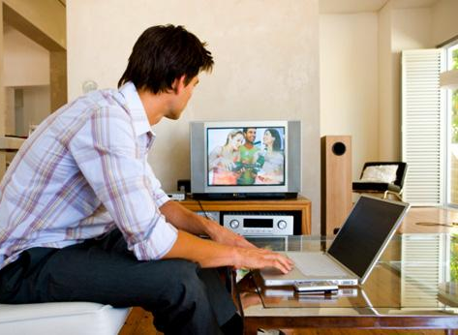
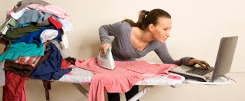
What is preventing you from being motivated?

Slide 5
Reestablishing Momentum
Do you work with the same level of intensity at home?
If your boss could see you working from home, would you change anything?
What is the one thing you do differently now that you are working from home?
*Share your response to 1 or 2 of the questions in the public chat box

Slide 6
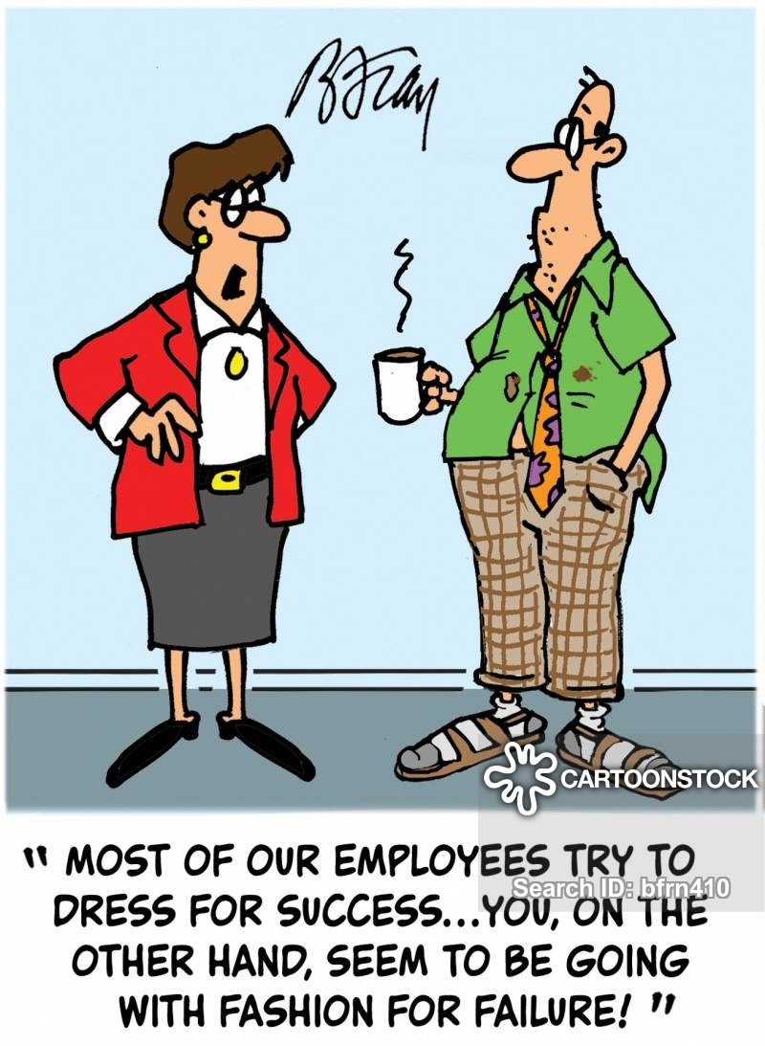
Prepare Yourself To Succeed

Slide 7
Maintaining Mental and Physical Health
Keep a regular schedule
Stay connected
Keep your immune system strong
Exercise and stay active
Get fresh air
Stay informed
Limit media consumption
Set boundaries on work schedule
Get creative to stay connected
*This is geared to specifically working from home during pandemic

Slide 8
Activity Time

Slide 9
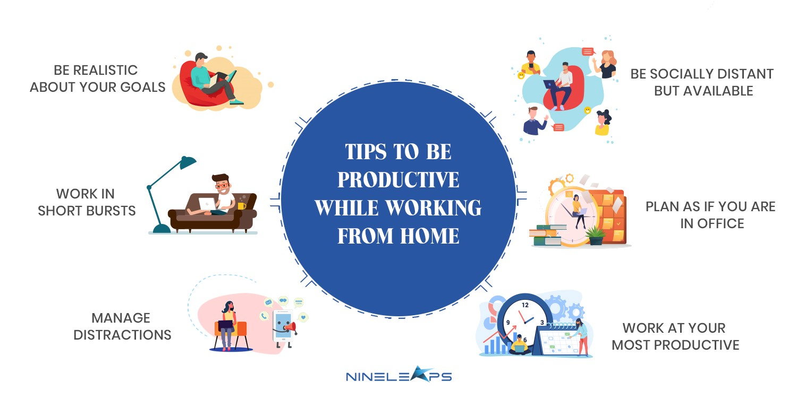
Physical Activity is
TIPS ON HOW TO MAINTAIN, MOTIVATE YOURSELF AND KEEP MOMETUM WHILE WORKING FROM HOME

Slide 10
REMEMBER
MAINTAIN your mental and physical health
recognize factors that’s prevented you from being MOTIVATED
create an environment that will provide you the needed MOMENTUM

